Slide 1
Capstone Design
Presentation
IMC
김원

Slide 2
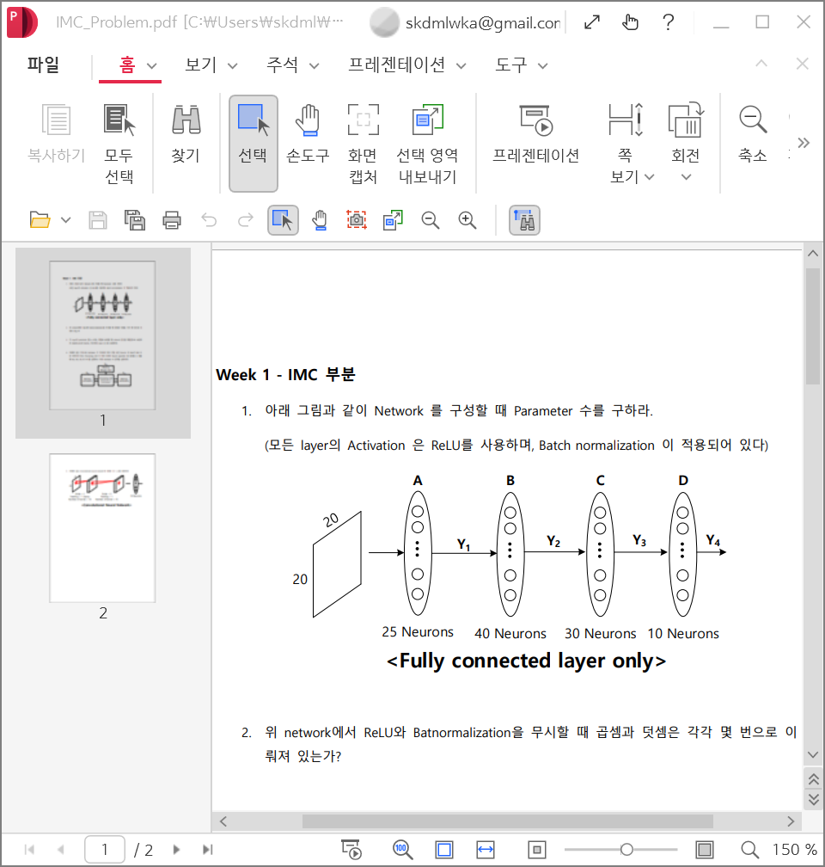
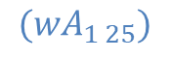
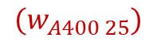
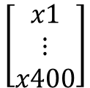
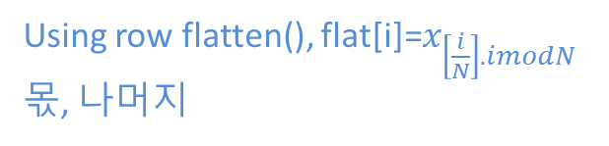
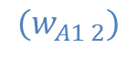
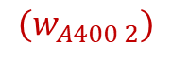
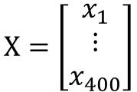
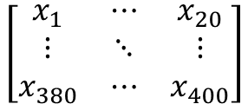
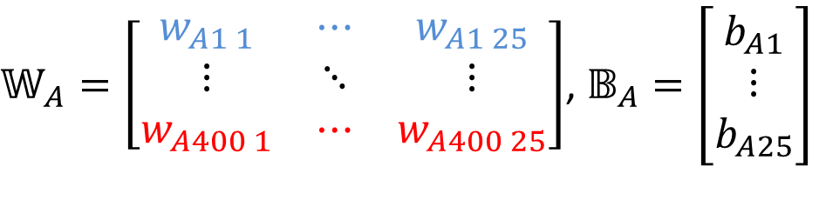
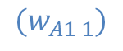
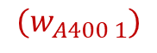



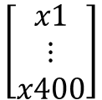
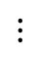
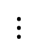
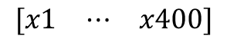
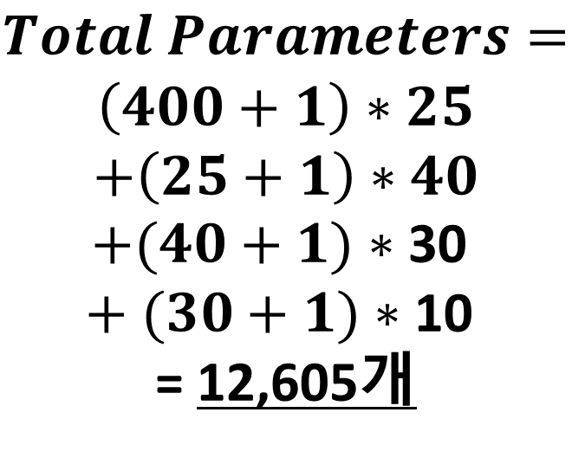
Problem 1
Total Parameter(weight, bias) 구하기
$$Parameters\left(at \left[ \right]\right)=\left(400+1\right)∗25=10,025$$
$Total$ $Parameters=$
$$\left(400+1\right)∗25$$
$$+\left(25+1\right)∗40$$
$+(40+1)$ $∗$30
$+ (30+1)$ $∗$10
= 12,605개
<Input data>
$$\left[\begin{matrix}x_{1} & ⋯ & x_{20} \\ ⋮ & ⋱ & ⋮ \\ x_{380} & ⋯ & x_{400}\end{matrix}\right]$$
$𝕎_{A}=\left[\begin{matrix}w_{A1 1} & ⋯ & w_{A1 25} \\ ⋮ & ⋱ & ⋮ \\ w_{A400 1} & ⋯ & w_{A400 25}\end{matrix}\right]$, $𝔹_{A}=\left[\begin{matrix}b_{A1} \\ ⋮ \\ b_{A25}\end{matrix}\right]$
B벡터는 각각의 뉴런에 해당하는 바이어스
20x20 행렬
Using row flatten(), flat[i]=$x_{\left[\frac{i}{N}\right].imodN}$
몫, 나머지
400x25
25x1
$$\begin{matrix}[x1 & ⋯ & x400]\end{matrix}$$
1x400
$$(w_{A1 1})$$
$$(w_{A400 1})$$
Transpose
$$\left[\begin{matrix}x1 \\ ⋮ \\ x400\end{matrix}\right]$$
$$(w_{A1 2})$$
$$(w_{A400 2})$$
$$⋮$$
$$⋯$$
$$\left[\begin{matrix}x1 \\ ⋮ \\ x400\end{matrix}\right]$$
$$⋮$$
$$X=\left[\begin{matrix}x_{1} \\ ⋮ \\ x_{400}\end{matrix}\right]$$
$$⋮$$
$$⋮$$
400x1
$$({wA}_{1 25})$$
$$(w_{A400 25})$$
*Total Parameters=(input+1)M1+(M1+1)M2+(M2+1)M3+(M3+1)M4

Slide 3
Problem 2, 3 (1/2)
곱셈, 덧셈 횟수 및 행렬 표현 구하기
${X=\left[\begin{matrix}x_{1} \\ ⋮ \\ x_{400}\end{matrix}\right], 𝕎}_{A}=\left[\begin{matrix}w_{A1 1} & ⋯ & w_{A1 25} \\ ⋮ & ⋱ & ⋮ \\ w_{A400 1} & ⋯ & w_{A400 25}\end{matrix}\right]$, $𝔹_{A}=\left[\begin{matrix}b_{A1} \\ ⋮ \\ b_{A25}\end{matrix}\right],{ 𝕎}_{B}=\left[\begin{matrix}w_{B1 1} & ⋯ & w_{B1 40} \\ ⋮ & ⋱ & ⋮ \\ w_{B25 1} & ⋯ & w_{B25 40}\end{matrix}\right]\text{,}𝔹_{B}=\left[\begin{matrix}b_{B1} \\ ⋮ \\ b_{B40}\end{matrix}\right]$
400x1
400x25
25x1
25x40
40x1
$A=\left[\begin{matrix}A_{1} \\ ⋮ \\ A_{25}\end{matrix}\right]={𝕎_{A}}^{T}×X+𝔹_{A}=\left[\begin{matrix}w_{A1 1} & ⋯ & w_{A400 1} \\ ⋮ & ⋱ & ⋮ \\ w_{A1 25} & ⋯ & w_{A400 25}\end{matrix}\right]×\left[\begin{matrix}x_{1} \\ ⋮ \\ x_{400}\end{matrix}\right]$+ $\left[\begin{matrix}b_{A1} \\ ⋮ \\ b_{A25}\end{matrix}\right]=\left[\begin{matrix}w_{A1 1}{∗x}_{1}+⋯+w_{A400 1}∗x_{400}+b_{A1} \\ ⋮ \\ w_{A1 25}∗x_{1}+⋯+w_{A400 25}∗x_{400}+b_{A25}\end{matrix}\right]$= $\left[\begin{matrix}A_{1} \\ ⋮ \\ A_{25}\end{matrix}\right]$
A layer에 존재하는 각각의 뉴런에 저장된 값
25x400
400x1
25x1
25x1
25x1
$$w_{A1 1}{∗x}_{1}+⋯+w_{A400 1}∗x_{400}+b_{A1}$$
한 행당, 곱 = 400, 덧셈 = 400
A layer에서 총 곱 횟수 = 10,000회, 총 덧셈 횟수 = 10,000회
$B=\left[\begin{matrix}B_{1} \\ ⋮ \\ B_{40}\end{matrix}\right]={𝕎_{B}}^{T}×Y_{1}+𝔹_{B}=\left[\begin{matrix}w_{B1 1} & ⋯ & w_{B25 1} \\ ⋮ & ⋱ & ⋮ \\ w_{B1 40} & ⋯ & w_{25 40}\end{matrix}\right]×\left[\begin{matrix}f(A_{1}) \\ ⋮ \\ f(A_{25})\end{matrix}\right]$+ $\left[\begin{matrix}b_{B1} \\ ⋮ \\ b_{B40}\end{matrix}\right]=\left[\begin{matrix}w_{B1 1}∗f\left(A_{1}\right)+⋯+w_{B25 1}∗f(A_{25})+b_{B1} \\ ⋮ \\ w_{B1 40}∗f\left(A_{1}\right)+⋯+w_{B25 40}∗f(A_{25})+b_{B40}\end{matrix}\right]$= $\left[\begin{matrix}B_{1} \\ ⋮ \\ B_{40}\end{matrix}\right]$
B layer에 존재하는 각각의 뉴런에 저장된 값
40x25
25x1
40x1
40x1
40x1
$$w_{B1 1}∗f\left(A_{1}\right)+⋯+w_{B25 1}∗f(A_{25})+b_{B1}$$
한 행당, 곱 = 25, 덧셈 = 25
B layer에서 총 곱 횟수 = 1,000회, 총 덧셈 횟수 = 1,000회
$$Y_{1}=f(A)=f({𝕎_{A}}^{T}⋅𝕏+𝔹_{A})$$

Slide 4
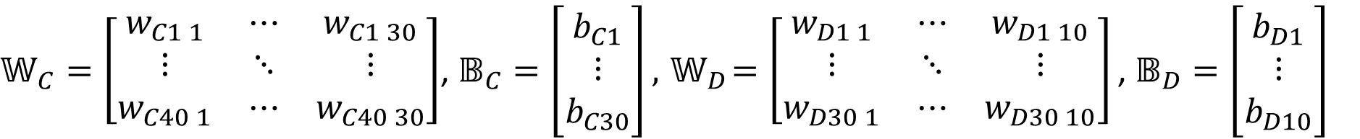
Problem 2, 3 (2/2)
곱셈, 덧셈 횟수 및 행렬 표현 구하기
$𝕎_{C}=\left[\begin{matrix}w_{C1 1} & ⋯ & w_{C1 30} \\ ⋮ & ⋱ & ⋮ \\ w_{C40 1} & ⋯ & w_{C40 30}\end{matrix}\right]$, $𝔹_{C}=\left[\begin{matrix}b_{C1} \\ ⋮ \\ b_{C30}\end{matrix}\right],{ 𝕎}_{D}=\left[\begin{matrix}w_{D1 1} & ⋯ & w_{D1 10} \\ ⋮ & ⋱ & ⋮ \\ w_{D30 1} & ⋯ & w_{D30 10}\end{matrix}\right]\text{,} 𝔹_{D}=\left[\begin{matrix}b_{D1} \\ ⋮ \\ b_{D10}\end{matrix}\right]$
40x30
30x1
30x10
10x1
$C=\left[\begin{matrix}C_{1} \\ ⋮ \\ C_{30}\end{matrix}\right]={𝕎_{C}}^{T}×Y_{2}+𝔹_{C}=\left[\begin{matrix}w_{C1 1} & ⋯ & w_{C40 1} \\ ⋮ & ⋱ & ⋮ \\ w_{C1 30} & ⋯ & w_{C40 30}\end{matrix}\right]$ $×\left[\begin{matrix}f(B_{1}) \\ ⋮ \\ f(B_{40})\end{matrix}\right]$+ $\left[\begin{matrix}b_{C1} \\ ⋮ \\ b_{C30}\end{matrix}\right]=\left[\begin{matrix}w_{C1 1}∗f\left(B_{1}\right)+⋯+w_{C40 1}∗f(B_{40})+b_{C1} \\ ⋮ \\ w_{C1 30}∗f\left(B_{1}\right)+⋯+w_{C40 30}∗f(B_{40})+b_{C30}\end{matrix}\right]$= $\left[\begin{matrix}C_{1} \\ ⋮ \\ C_{30}\end{matrix}\right]$
C layer에 존재하는 각각의 뉴런에 저장된 값
30x40
40x1
30x1
30x1
30x1
$$w_{C1 1}∗f\left(B_{1}\right)+⋯+w_{C40 1}∗f(B_{40})+b_{C1}$$
한 행당, 곱 = 40, 덧셈 = 40
C layer에서 총 곱 횟수 = 1,200회, 총 덧셈 횟수 = 1,200회
$D=\left[\begin{matrix}D_{1} \\ ⋮ \\ D_{10}\end{matrix}\right]={𝕎_{D}}^{T}×Y_{3}+𝔹_{D}=\left[\begin{matrix}w_{D1 1} & ⋯ & w_{D30 1} \\ ⋮ & ⋱ & ⋮ \\ w_{D1 10} & ⋯ & w_{D30 10}\end{matrix}\right]×\left[\begin{matrix}f(C_{1}) \\ ⋮ \\ f(C_{30})\end{matrix}\right]$+ $\left[\begin{matrix}b_{D1} \\ ⋮ \\ b_{D10}\end{matrix}\right]=\left[\begin{matrix}w_{D1 1}∗f\left(C_{1}\right)+⋯+w_{D30 1}∗f(C_{30})+b_{D1} \\ ⋮ \\ w_{D1 10}∗f\left(C_{1}\right)+⋯+w_{D30 10}∗f(C_{30})+b_{D10}\end{matrix}\right]$= $\left[\begin{matrix}D_{1} \\ ⋮ \\ D_{10}\end{matrix}\right]$
D layer에 존재하는 각각의 뉴런에 저장된 값
10x30
30x1
10x1
10x1
10x1
$$w_{D1 1}∗f\left(C_{1}\right)+⋯+w_{D30 1}∗f(C_{30})+b_{D1}$$
한 행당, 곱 = 30, 덧셈 = 30
D layer에서 총 곱 횟수 = 300회, 총 덧셈 횟수 = 300회
$Y_{2}=f(B)=f({𝕎_{B}}^{T}⋅Y_{1}+𝔹_{B})$, $Y_{3}=f\left(C\right)=f\left({𝕎_{C}}^{T}⋅Y_{2}+𝔹_{C}\right), Y_{4}=f(D)$=$f({𝕎_{D}}^{T}⋅Y_{3}+𝔹_{D})$

Slide 5
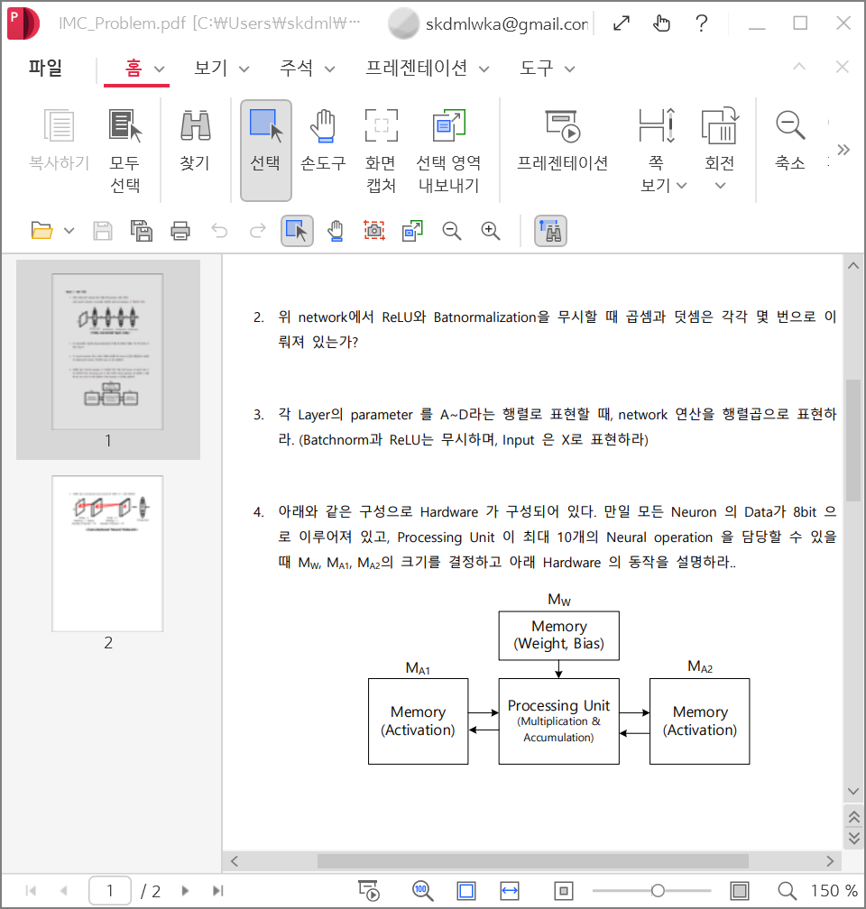
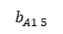
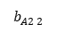
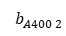
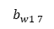
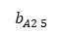
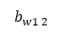
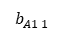

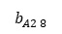
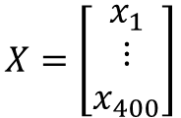

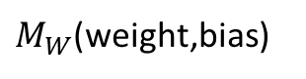
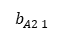
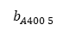
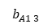
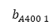
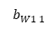
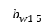
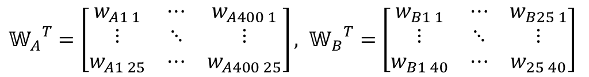
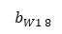
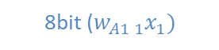

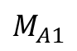
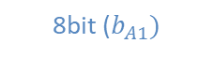
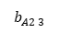
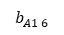
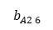
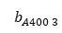
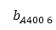
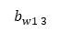
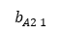
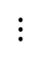
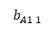
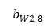
























Problem 4
Hardware 크기 및 동작 원리
$<$구조 $>$
$$X=\left[\begin{matrix}x_{1} \\ ⋮ \\ x_{400}\end{matrix}\right]$$
${𝕎_{A}}^{T}=\left[\begin{matrix}w_{A1 1} & ⋯ & w_{A400 1} \\ ⋮ & ⋱ & ⋮ \\ w_{A1 25} & ⋯ & w_{A400 25}\end{matrix}\right],$ ${{ 𝕎}_{B}}^{T}=\left[\begin{matrix}w_{B1 1} & ⋯ & w_{B25 1} \\ ⋮ & ⋱ & ⋮ \\ w_{B1 40} & ⋯ & w_{25 40}\end{matrix}\right]$
decoder
$$M_{A1}$$
decoder
$M_{W}$(weight,bias)
$$b_{A1 1}$$
$$b_{A1 2}$$
$$b_{A1 3}$$
$$b_{A1 4}$$
$$b_{A1 5}$$
$$b_{A1 6}$$
$$b_{A1 7}$$
$$b_{A1 8}$$
$$b_{W1 1}$$
$$b_{w1 2}$$
$$b_{w1 3}$$
$$b_{w1 4}$$
$$b_{w1 5}$$
$$b_{w1 6}$$
$$b_{w1 7}$$
$$b_{w1 8}$$
: sram (12tr)
$$b_{A2 1}$$
$$b_{A2 2}$$
$$b_{A2 3}$$
$$b_{A2 4}$$
$$b_{A2 5}$$
$$b_{A2 6}$$
$$b_{A2 7}$$
$$b_{A2 8}$$
$$⋮$$
$$⋮$$
$$b_{A400 1}$$
$$b_{A400 2}$$
$$b_{A400 3}$$
$$b_{A400 4}$$
$$b_{A400 5}$$
$$b_{A400 6}$$
$$b_{A400 7}$$
$$b_{A400 8}$$
$M_{A1}$: 3,200bit, $M_{W}$: 80,200bit, $M_{A2}$: 240bit(30x8b)
400x8
10,025x8
$M_{A1}에$ Input data($X [$400x1]) write, $M_{w}에$ ${𝕎_{A}}^{T}$ [25x400] data write
Processing Unit(logic), $M_{A1} 에 첫행에 저장된 x_{1}$(8bit) & $M_{W}에$ 저장되어있는 ${𝕎_{A}}^{T}$의 $w_{A1 1}$ 이 저장되어 있는 1행 8bit 을 read
후 ${{ 𝕎}_{B}}^{T}$의 $w_{B1 1}$값 write
읽어온 bit를 각각 and 연산
각각의 and 연산된 bit를 sum 해주기위해 8비트 가산기로 누적해서 더해줌
마지막 가산기에서 첫번째 뉴런의 바이어스 값인 $b_{A1}$ 을 더해줌
마지막 가산기에서 나온 출력($A_{1}$= $\sum_{i=1}^{400}{w_{Ai 1}}x_{i}$+ $b_{A1}$)을 ReLU, ${f(A}_{1})$ 후, $M_{A2}$의 첫번째 행에 write
2~7을 반복하여 $A \left[25x1\right]$열벡터을 $M_{A2}$에 write
$$b_{A1 1}$$
$$b_{W1 1}$$
$$⋮$$
$$b_{A1 8}$$
8bit ($w_{A1 1}x_{1})$
$$b_{W1 8}$$
$$⋮$$
$$b_{A2 1}$$
8bit ($w_{A2 1}x_{2})$
$\sum_{i=1}^{400}{w_{Ai 1}}x_{i}$+ $b_{A1}$
$$b_{W2 1}$$
x100
x50
x200
$$⋮$$
$$⋮$$
$$⋮$$
$$⋮$$
$$⋮$$
$$b_{A2 8}$$
8bit ($b_{A1})$
$$b_{W2 8}$$
x400
$$⋮$$
: 8*400=3,200개,
: 200+100+50+25+13+7+4+2+1+1=403개

Slide 6

















Problem 4
처음 고안한것
Chip 크기가 늘어남
$$M_{W1}$$
$$M_{W2}$$
$$M_{W2}$$
$$M_{W2}$$
weight
decoder
EN
decoder
$$b_{W1 1}$$
$$b_{w1 2}$$
$$b_{w1 3}$$
$$b_{w1 4}$$
$$b_{w1 5}$$
$$b_{w1 6}$$
$$b_{w1 7}$$
$$b_{w1 8}$$
EN
decoder
EN
decoder
EN
decoder
$$W_{s0}$$
$$⋮$$
$$⋮$$
$$⋮$$
$$W_{s1}$$
$$⋮$$
8비트 곱셈 결과 16비트
-> 추가 연산 필요..
$$M_{A1}$$
EN
decoder
8bit 곱셈기
8bit 가산기
$$⋮$$
$$⋮$$
x400
8bit 가산기
$$⋮$$
x200
$$⋮$$
8bit 곱셈기
8bit 가산기

Slide 7




































Problem 5
1) Total Parameter 구하기
$$𝔸$$
$$𝔹$$
Cf)
$Total$ $Parameters=$
$$\left(3∗3∗1\right)∗10+10$$
$$+\left(3∗3∗10\right)∗15+15$$
$+(1350+1$)*10
= 16,475개
$$H_{out}= \frac{H_{in}+2P−K}{Stride}+1$$
$$Y_{2}$$
$$W_{out}= \frac{W_{in}+2P−K}{Stride}+1$$
20x20x10(channel)
10x10x15(channel)
10
$$Y_{2}=\left[\begin{matrix}y_{1} \\ ⋮ \\ y_{1500}\end{matrix}\right]$$
$${{ w}_{1 1}}^{1}$$ | $${{ w}_{1 2}}^{1}$$ | $${{ w}_{1 3}}^{1}$$
$${{ w}_{2 1}}^{1}$$ | $${{ w}_{2 2}}^{1}$$ | $${{ w}_{2 3}}^{1}$$
$${{ w}_{3 1}}^{1}$$ | $${{ w}_{3 2}}^{1}$$ | $${{ w}_{3 3}}^{1}$$
1500x1
$${{ w}_{1 1}}^{1}$$ | $${{ w}_{1 2}}^{1}$$ | $${{ w}_{1 3}}^{1}$$
$${{ w}_{2 1}}^{1}$$ | $${{ w}_{2 2}}^{1}$$ | $${{ w}_{2 3}}^{1}$$
$${{ w}_{3 1}}^{1}$$ | $${{ w}_{3 2}}^{1}$$ | $${{ w}_{3 3}}^{1}$$
$${{ w}_{1 1}}^{1}$$ | $${{ w}_{1 2}}^{1}$$ | $${{ w}_{1 3}}^{1}$$
$${{ w}_{2 1}}^{1}$$ | $${{ w}_{2 2}}^{1}$$ | $${{ w}_{2 3}}^{1}$$
$${{ w}_{3 1}}^{1}$$ | $${{ w}_{3 2}}^{1}$$ | $${{ w}_{3 3}}^{1}$$
$$⋱$$
$${{ w}_{1 1}}^{1}$$ | $${{ w}_{1 2}}^{1}$$ | $${{ w}_{1 3}}^{1}$$
$${{ w}_{2 1}}^{1}$$ | $${{ w}_{2 2}}^{1}$$ | $${{ w}_{2 3}}^{1}$$
$${{ w}_{3 1}}^{1}$$ | $${{ w}_{3 2}}^{1}$$ | $${{ w}_{3 3}}^{1}$$
$${{ w}_{1 1}}^{1}$$ | $${{ w}_{1 2}}^{1}$$ | $${{ w}_{1 3}}^{1}$$
$${{ w}_{2 1}}^{1}$$ | $${{ w}_{2 2}}^{1}$$ | $${{ w}_{2 3}}^{1}$$
$${{ w}_{3 1}}^{1}$$ | $${{ w}_{3 2}}^{1}$$ | $${{ w}_{3 3}}^{1}$$
$${{ w}_{1 1}}^{1}$$ | $${{ w}_{1 2}}^{1}$$ | $${{ w}_{1 3}}^{1}$$
$${{ w}_{2 1}}^{1}$$ | $${{ w}_{2 2}}^{1}$$ | $${{ w}_{2 3}}^{1}$$
$${{ w}_{3 1}}^{1}$$ | $${{ w}_{3 2}}^{1}$$ | $${{ w}_{3 3}}^{1}$$
$${{ w}_{1 1}}^{10}$$ | $${{ w}_{1 2}}^{10}$$ | $${{ w}_{1 3}}^{10}$$
$${{ w}_{2 1}}^{10}$$ | $${{ w}_{2 2}}^{10}$$ | $${{ w}_{2 3}}^{10}$$
$${{ w}_{3 1}}^{10}$$ | $${{ w}_{3 2}}^{10}$$ | $${{ w}_{3 3}}^{10}$$
$${{ w}_{1 1}}^{1}$$ | $${{ w}_{1 2}}^{1}$$ | $${{ w}_{1 3}}^{1}$$
$${{ w}_{2 1}}^{1}$$ | $${{ w}_{2 2}}^{1}$$ | $${{ w}_{2 3}}^{1}$$
$${{ w}_{3 1}}^{1}$$ | $${{ w}_{3 2}}^{1}$$ | $${{ w}_{3 3}}^{1}$$
$${{ w}_{1 1}}^{1}$$ | $${{ w}_{1 2}}^{1}$$ | $${{ w}_{1 3}}^{1}$$
$${{ w}_{2 1}}^{1}$$ | $${{ w}_{2 2}}^{1}$$ | $${{ w}_{2 3}}^{1}$$
$${{ w}_{3 1}}^{1}$$ | $${{ w}_{3 2}}^{1}$$ | $${{ w}_{3 3}}^{1}$$
$${{ w}_{1 1}}^{1}$$ | $${{ w}_{1 2}}^{1}$$ | $${{ w}_{1 3}}^{1}$$
$${{ w}_{2 1}}^{1}$$ | $${{ w}_{2 2}}^{1}$$ | $${{ w}_{2 3}}^{1}$$
$${{ w}_{3 1}}^{1}$$ | $${{ w}_{3 2}}^{1}$$ | $${{ w}_{3 3}}^{1}$$
$$⋱$$
$${{ w}_{1 1}}^{1}$$ | $${{ w}_{1 2}}^{1}$$ | $${{ w}_{1 3}}^{1}$$
$${{ w}_{2 1}}^{1}$$ | $${{ w}_{2 2}}^{1}$$ | $${{ w}_{2 3}}^{1}$$
$${{ w}_{3 1}}^{15}$$ | $${{ w}_{3 2}}^{15}$$ | $${{ w}_{3 3}}^{15}$$
$${{ w}_{1 1}}^{2}$$ | $${{ w}_{1 2}}^{2}$$ | $${{ w}_{1 3}}^{2}$$
$${{ w}_{2 1}}^{2}$$ | $${{ w}_{2 2}}^{2}$$ | $${{ w}_{2 3}}^{2}$$
$${{ w}_{3 1}}^{2}$$ | $${{ w}_{3 2}}^{2}$$ | $${{ w}_{3 3}}^{2}$$
b10
10
b15
$${{ w}_{1 1}}^{1}$$ | $${{ w}_{1 2}}^{1}$$ | $${{ w}_{1 3}}^{1}$$
$${{ w}_{2 1}}^{1}$$ | $${{ w}_{2 2}}^{1}$$ | $${{ w}_{2 3}}^{1}$$
$${{ w}_{3 1}}^{1}$$ | $${{ w}_{3 2}}^{1}$$ | $${{ w}_{3 3}}^{1}$$
$$⋱$$
$${{ w}_{1 1}}^{1}$$ | $${{ w}_{1 2}}^{1}$$ | $${{ w}_{1 3}}^{1}$$
$${{ w}_{2 1}}^{1}$$ | $${{ w}_{2 2}}^{1}$$ | $${{ w}_{2 3}}^{1}$$
$${{ w}_{3 1}}^{1}$$ | $${{ w}_{3 2}}^{1}$$ | $${{ w}_{3 3}}^{1}$$
$${{ w}_{1 1}}^{1}$$ | $${{ w}_{1 2}}^{1}$$ | $${{ w}_{1 3}}^{1}$$
$${{ w}_{2 1}}^{1}$$ | $${{ w}_{2 2}}^{1}$$ | $${{ w}_{2 3}}^{1}$$
$${{ w}_{3 1}}^{1}$$ | $${{ w}_{3 2}}^{1}$$ | $${{ w}_{3 3}}^{1}$$
$${{ w}_{1 1}}^{1}$$ | $${{ w}_{1 2}}^{1}$$ | $${{ w}_{1 3}}^{1}$$
$${{ w}_{2 1}}^{1}$$ | $${{ w}_{2 2}}^{1}$$ | $${{ w}_{2 3}}^{1}$$
$${{ w}_{3 1}}^{1}$$ | $${{ w}_{3 2}}^{1}$$ | $${{ w}_{3 3}}^{1}$$
$${{ w}_{1 1}}^{1}$$ | $${{ w}_{1 2}}^{1}$$ | $${{ w}_{1 3}}^{1}$$
$${{ w}_{2 1}}^{1}$$ | $${{ w}_{2 2}}^{1}$$ | $${{ w}_{2 3}}^{1}$$
$${{ w}_{3 1}}^{1}$$ | $${{ w}_{3 2}}^{1}$$ | $${{ w}_{3 3}}^{1}$$
$${{ w}_{1 1}}^{1}$$ | $${{ w}_{1 2}}^{1}$$ | $${{ w}_{1 3}}^{1}$$
$${{ w}_{2 1}}^{1}$$ | $${{ w}_{2 2}}^{1}$$ | $${{ w}_{2 3}}^{1}$$
$${{ w}_{3 1}}^{1}$$ | $${{ w}_{3 2}}^{1}$$ | $${{ w}_{3 3}}^{1}$$
$${{ w}_{1 1}}^{1}$$ | $${{ w}_{1 2}}^{1}$$ | $${{ w}_{1 3}}^{1}$$
$${{ w}_{2 1}}^{1}$$ | $${{ w}_{2 2}}^{1}$$ | $${{ w}_{2 3}}^{1}$$
$${{ w}_{3 1}}^{1}$$ | $${{ w}_{3 2}}^{1}$$ | $${{ w}_{3 3}}^{1}$$
$${{ w}_{1 1}}^{1}$$ | $${{ w}_{1 2}}^{1}$$ | $${{ w}_{1 3}}^{1}$$
$${{ w}_{2 1}}^{1}$$ | $${{ w}_{2 2}}^{1}$$ | $${{ w}_{2 3}}^{1}$$
$${{ w}_{3 1}}^{1}$$ | $${{ w}_{3 2}}^{1}$$ | $${{ w}_{3 3}}^{1}$$
$𝕎=\left[\begin{matrix}w_{1 1} & ⋯ & w_{1 10} \\ ⋮ & ⋱ & ⋮ \\ w_{1500 1} & ⋯ & w_{1500 10}\end{matrix}\right]$, $𝔹=\left[\begin{matrix}b_{1} \\ ⋮ \\ b_{10}\end{matrix}\right]$
$${{ w}_{1 1}}^{1}$$ | $${{ w}_{1 2}}^{1}$$ | $${{ w}_{1 3}}^{1}$$
$${{ w}_{2 1}}^{1}$$ | $${{ w}_{2 2}}^{1}$$ | $${{ w}_{2 3}}^{1}$$
$${{ w}_{3 1}}^{1}$$ | $${{ w}_{3 2}}^{1}$$ | $${{ w}_{3 3}}^{1}$$
$${{ w}_{1 1}}^{1}$$ | $${{ w}_{1 2}}^{1}$$ | $${{ w}_{1 3}}^{1}$$
$${{ w}_{2 1}}^{1}$$ | $${{ w}_{2 2}}^{1}$$ | $${{ w}_{2 3}}^{1}$$
$${{ w}_{3 1}}^{1}$$ | $${{ w}_{3 2}}^{1}$$ | $${{ w}_{3 3}}^{1}$$
b2
$${{ w}_{1 1}}^{1}$$ | $${{ w}_{1 2}}^{1}$$ | $${{ w}_{1 3}}^{1}$$
$${{ w}_{2 1}}^{1}$$ | $${{ w}_{2 2}}^{1}$$ | $${{ w}_{2 3}}^{1}$$
$${{ w}_{3 1}}^{1}$$ | $${{ w}_{3 2}}^{1}$$ | $${{ w}_{3 3}}^{1}$$
(15)
$$⋱$$
b1
b1
(1)
Parameters = (3x3x1)x10+10 = 100
Parameters = (3x3x10)x15+15 = 1,365
Parameters = (1500+1)x10 = 15,010
Parameters = (K x # of input channel) x # of kernel + # of kernel
- K : kernel size(kernel width * kernel length)

Slide 8












Problem 5
2,3) 곱셈, 덧셈 횟수 및 행렬 표현 구하기 (1/7)
Kernel size = 3x3, stride = 1에 맞게 padding이 적용된 input data의 3x3 capture 행렬을 $𝕏_{f}\left(i,j\right)행$렬 형태로 만듬 (im2col)
${ 𝕏}_{f}\left(i,j\right)행$렬을 row flatten 후, Transpose
각 행의 요소를 flatten
Cf) $X_{f}(q,p)=$ $\left[\begin{matrix}X_{p}\left(q,p\right) & X_{p}\left(q,p+1\right) & X_{p}\left(q,p+2\right) \\ X_{p}\left(q+1,p\right) & X_{p}\left(q+1,p+1\right) & X_{p}\left(q+1,p+2\right) \\ X_{p}\left(q+2,p\right) & X_{p}\left(q+2,p+1\right) & X_{p}\left(q+2,p+2\right)\end{matrix}\right]$
Using row flatten(), flat[i]=$x_{\left[\frac{i}{N}\right].imodN}$
<Input data>
$$𝕏=\left[\begin{matrix}x_{1 1} & ⋯ & x_{1 20} \\ ⋮ & ⋱ & ⋮ \\ x_{20 1} & ⋯ & x_{20 20}\end{matrix}\right]$$
$$X_{f}(0,0)=\left[\begin{matrix}0 & 0 & 0 \\ 0 & x_{1 1} & x_{1 2} \\ 0 & x_{2 1} & x_{2 2}\end{matrix}\right]$$
$𝕏_{f}(i,j)=\left[\begin{matrix}X_{f}\left(0,0\right) & X_{f}\left(0,1\right) & ⋯ & X_{f}\left(0,19\right) \\ X_{f}\left(1,0\right) & X_{f}\left(1,1\right) & ⋯ & X_{f}\left(1,19\right) \\ ⋮ & ⋮ & ⋱ & ⋮ \\ X_{f}\left(19,0\right) & X_{f}\left(19,1\right) & ⋯ & X_{f}\left(19,19\right)\end{matrix}\right]$
$⇒ \left[\begin{matrix}{flatten(X}_{f}\left(0,0\right)) \\ {flatten(X}_{f}\left(0,1\right)) \\ ⋮ \\ {flatten(X}_{f}\left(19,19\right))\end{matrix}\right]$ = $\left[\begin{matrix}0 & 0 & 0 & 0 & x_{1 1} & x_{1 2} & 0 & x_{2 1} & x_{2 2} \\ 0 & 0 & 0 & x_{1 1} & x_{1 2} & x_{1 3} & x_{2 1} & x_{2 2} & x_{2 3} \\ ⋮ & ⋮ & ⋮ & ⋮ & ⋮ & ⋮ & ⋮ & ⋮ & ⋮ \\ x_{19 19} & x_{19 20} & 0 & x_{20 19} & x_{20 20} & 0 & 0 & 0 & 0\end{matrix}\right]$
$$=\left[\begin{matrix}{ X}_{f1} \\ { X}_{f2} \\ ⋮ \\ { X}_{f400}\end{matrix}\right]=𝕏_{f}$$
$$\begin{matrix}\left[0 0 0 0 x_{1 1} x_{1 2} 0 x_{2 1} x_{2 2}\right]\end{matrix}$$
1x9
20x20x(1channel) 행렬
$$X_{f}(0,1)=\left[\begin{matrix}0 & 0 & 0 \\ x_{1 1} & x_{1 2} & x_{1 3} \\ x_{2 1} & x_{2 2} & x_{2 3}\end{matrix}\right]$$
Padding=1 적용
$$\begin{matrix}\left[0 0 0 x_{1 1}{ x}_{1 2} x_{1 3}{ x}_{2 1} x_{2 2} x_{2 3}\right]\end{matrix}$$
1x9
$$𝕏_{p}=\left[\begin{matrix}0 & 0 & ⋯ & 0 & 0 \\ 0 & x_{1 1} & ⋯ & x_{1 20} & 0 \\ ⋮ & ⋮ & ⋱ & ⋮ & ⋮ \\ 0 & x_{20 1} & ⋯ & x_{20 20} & 0 \\ 0 & 0 & ⋯ & 0 & 0\end{matrix}\right]$$
$$⋮$$
$$⋮$$
400x9
$$X_{f}(19,19)= \left[\begin{matrix}x_{19 19} & x_{19 20 } & 0 \\ x_{20 19} & x_{20 20} & 0 \\ 0 & 0 & 0\end{matrix}\right]$$
$$\begin{matrix}\left[x_{19 19}{ x}_{19 20} 0 x_{20 19} x_{20 20}0 0 0 0\right]\end{matrix}$$
22x22x(1channel) 행렬
1x9
Cf) $X_{f1}=\left[\begin{matrix}0 & 0 & 0 & 0 & x_{1 1} & x_{1 2} & 0 & x_{2 1} & x_{2 2}\end{matrix}\right]$

Slide 9















Problem 5
2,3) 곱셈, 덧셈 횟수 및 행렬 표현 구하기 (2/7)
Kernel 도 input data 처럼 flatten 하여 10x9 행렬 만듬 이때, 행은 # of kernels 수와 같음
Using row flatten(), flat[i]=$w_{\left[\frac{i}{N}\right].imodN}$
몫, 나머지
<kernel(weight)>
$${{ w}_{1 1}}^{1}$$ | $${{ w}_{1 2}}^{1}$$ | $${{ w}_{1 3}}^{1}$$
$${{ w}_{2 1}}^{1}$$ | $${{ w}_{2 2}}^{1}$$ | $${{ w}_{2 3}}^{1}$$
$${{ w}_{3 1}}^{1}$$ | $${{ w}_{3 2}}^{1}$$ | $${{ w}_{3 3}}^{1}$$
$$\begin{matrix}\left[{{ w}_{1 1}}^{1}{{ w}_{1 2}}^{1}{{ w}_{1 3}}^{1}{{ w}_{2 1}}^{1}{{ w}_{2 2}}^{1}{{ w}_{2 3}}^{1}{{ w}_{3 1}}^{1}{{ w}_{3 2}}^{1}{{ w}_{3 3}}^{1}\right] \end{matrix}$$
$$⋱$$
$${{ w}_{1 1}}^{10}$$ | $${{ w}_{1 2}}^{10}$$ | $${{ w}_{1 3}}^{10}$$
$${{ w}_{2 1}}^{10}$$ | $${{ w}_{2 2}}^{10}$$ | $${{ w}_{2 3}}^{10}$$
$${{ w}_{3 1}}^{10}$$ | $${{ w}_{3 2}}^{10}$$ | $${{ w}_{3 3}}^{10}$$
1x9
$${{ w}_{1 1}}^{2}$$ | $${{ w}_{1 2}}^{2}$$ | $${{ w}_{1 3}}^{2}$$
$${{ w}_{2 1}}^{2}$$ | $${{ w}_{2 2}}^{2}$$ | $${{ w}_{2 3}}^{2}$$
$${{ w}_{3 1}}^{2}$$ | $${{ w}_{3 2}}^{2}$$ | $${{ w}_{3 3}}^{2}$$
$$𝕎=\left[\begin{matrix}{{ w}_{1 1}}^{1} & {{ w}_{1 2}}^{1} & {{ w}_{1 3}}^{1} & {{ w}_{2 1}}^{1} & {{ w}_{2 2}}^{1} & {{ w}_{2 3}}^{1} & {{ w}_{3 1}}^{1} & {{ w}_{3 2}}^{1} & {{ w}_{3 3}}^{1} \\ ⋮ & ⋮ & ⋮ & ⋮ & ⋮ & ⋮ & ⋮ & ⋮ & ⋮ \\ {{ w}_{1 1}}^{10} & {{ w}_{1 2}}^{10} & {{ w}_{1 3}}^{10} & {{ w}_{2 1}}^{10} & {{ w}_{2 2}}^{10} & {{ w}_{2 3}}^{10} & {{ w}_{3 1}}^{10} & {{ w}_{3 2}}^{10} & {{ w}_{3 3}}^{10}\end{matrix}\right]$$
$${{ w}_{1 1}}^{1}$$ | $${{ w}_{1 2}}^{1}$$ | $${{ w}_{1 3}}^{1}$$
$${{ w}_{2 1}}^{1}$$ | $${{ w}_{2 2}}^{1}$$ | $${{ w}_{2 3}}^{1}$$
$${{ w}_{3 1}}^{1}$$ | $${{ w}_{3 2}}^{1}$$ | $${{ w}_{3 3}}^{1}$$
$$⋮$$
$$⋮$$
$${{ w}_{1 1}}^{10}$$ | $${{ w}_{1 2}}^{10}$$ | $${{ w}_{1 3}}^{10}$$
$${{ w}_{2 1}}^{10}$$ | $${{ w}_{2 2}}^{10}$$ | $${{ w}_{2 3}}^{10}$$
$${{ w}_{3 1}}^{10}$$ | $${{ w}_{3 2}}^{10}$$ | $${{ w}_{3 3}}^{10}$$
10x9
Transpose
$$\begin{matrix}\left[{{ w}_{1 1}}^{1}{{ w}_{1 2}}^{1}{{ w}_{1 3}}^{1}{{ w}_{2 1}}^{1}{{ w}_{2 2}}^{1}{{ w}_{2 3}}^{1}{{ w}_{3 1}}^{1}{{ w}_{3 2}}^{1}{{ w}_{3 3}}^{1}\right] \end{matrix}$$
Transpose
Cf) $W^{i}=\left[\begin{matrix}{{ w}_{1 1}}^{i} \\ ⋮ \\ {{ w}_{3 3}}^{i}\end{matrix}\right]$
$𝕎^{T}=\left[\begin{matrix}{{ w}_{1 1}}^{1} & {{ w}_{1 1}}^{2} & ⋯ & {{ w}_{1 1}}^{10} \\ ⋮ & ⋮ & ⋱ & ⋮ \\ {{ w}_{3 3}}^{1} & {{ w}_{3 3}}^{2} & ⋯ & {{ w}_{3 3}}^{10}\end{matrix}\right]$ $=\left[\begin{matrix}W^{1} & W^{2} & ⋯ & W^{10}\end{matrix}\right]$
1x9
9x10
<kernel(bias)>
Broadcasting
$$⋱$$
b10
$B=\left[\begin{matrix}b^{1} \\ ⋮ \\ b^{10}\end{matrix}\right]$, $B^{T}=\left[\begin{matrix}b^{1} & ⋯ & b^{10}\end{matrix}\right]$
$$B^{′}=\left[\begin{matrix}b^{1} & ⋯ & b^{10} \\ ⋮ & ⋱ & ⋮ \\ b^{1} & ⋯ & b^{10}\end{matrix}\right]$$
b2
b1
1x10
400x10

Slide 10



Problem 5
2,3) 곱셈, 덧셈 횟수 및 행렬 표현 구하기 (3/7)
${𝕏_{f}× 𝕎}^{T}+B^{′}=\left[\begin{matrix}0 & 0 & 0 & 0 & x_{1 1} & x_{1 2} & 0 & x_{2 1} & x_{2 2} \\ 0 & 0 & 0 & x_{1 1} & x_{1 2} & x_{1 3} & x_{2 1} & x_{2 2} & x_{2 3} \\ ⋮ & ⋮ & ⋮ & ⋮ & ⋮ & ⋮ & ⋮ & ⋮ & ⋮ \\ x_{20 20} & 0 & 0 & 0 & 0 & 0 & 0 & 0 & 0\end{matrix}\right]×\left[\begin{matrix}{{ w}_{1 1}}^{1} & {{ w}_{1 1}}^{2} & ⋯ & {{ w}_{1 1}}^{10} \\ ⋮ & ⋮ & ⋱ & ⋮ \\ {{ w}_{3 3}}^{1} & {{ w}_{3 3}}^{2} & ⋯ & {{ w}_{3 3}}^{10}\end{matrix}\right]$ $+\left[\begin{matrix}b^{1} & ⋯ & b^{10} \\ ⋮ & ⋱ & ⋮ \\ b^{1} & ⋯ & b^{10}\end{matrix}\right]=\left[\begin{matrix}0∗{{ w}_{1 1}}^{1}+⋯+x_{2 2}∗{{ w}_{3 3}}^{1}+b1 & ⋯ & 0∗{{ w}_{1 1}}^{10}+⋯+x_{2 2}∗{{ w}_{3 3}}^{10}+b10 \\ 0∗{{ w}_{1 1}}^{1}+⋯+x_{2 3}∗{{ w}_{3 3}}^{1}+b1 & ⋯ & 0∗{{ w}_{1 1}}^{10}+⋯+x_{2 3}∗{{ w}_{3 3}}^{10}+b10 \\ ⋮ & ⋱ & ⋮ \\ x_{20 20}∗{{ w}_{1 1}}^{1}+⋯+0∗{{ w}_{3 3}}^{1}+b1 & ⋯ & x_{20 20}∗{{ w}_{1 1}}^{10}+⋯+0∗{{ w}_{3 3}}^{10}+b10\end{matrix}\right]$
$$= \left[\begin{matrix}X_{f1}{×W}^{1}+b1 & ⋯ & X_{f1}{×W}^{10}+b10 \\ X_{f2}{×W}^{1}+b1 & ⋯ & X_{f2}{×W}^{10}+b10 \\ ⋮ & ⋱ & ⋮ \\ X_{f400}{×W}^{1}+b1 & ⋯ & X_{f400}{×W}^{10}+b10\end{matrix}\right]=𝔸=\left[\begin{matrix}{A_{1}}^{1} & ⋯ & {A_{1}}^{10} \\ {A_{2}}^{1} & ⋯ & {A_{2}}^{10} \\ ⋮ & ⋱ & ⋮ \\ {A_{400}}^{1} & ⋯ & {A_{400}}^{10}\end{matrix}\right]$$
400x9
9x10
400x10
400x10
400x10
10
$$⋱$$
$$𝔸=$$
A의 한 채널 당, 곱 횟수 = 9*400회, 덧셈 횟수 = 9*400회
총 곱, 덧셈 횟수 = 9*400*10 = 36,000회
20
20x20x10
20

Slide 11


























Problem 5
2,3) 곱셈, 덧셈 횟수 및 행렬 표현 구하기 (4/7)
A의 10개의 channel 과 첫번째 kernel의 10개의 channel 과 각각 대응해서 컨볼루션, 각 결과를 Sum 해주면, 한 개의 Output channel 생성
$${{ w}_{1 1}}^{1}$$ | $${{ w}_{1 2}}^{1}$$ | $${{ w}_{1 3}}^{1}$$
$${{ w}_{2 1}}^{1}$$ | $${{ w}_{2 2}}^{1}$$ | $${{ w}_{2 3}}^{1}$$
$${{ w}_{3 1}}^{1}$$ | $${{ w}_{3 2}}^{1}$$ | $${{ w}_{3 3}}^{1}$$
10
*
$$=$$
10x10
$$=$$
$$B_{1}$$
$$⋱$$
+
10
$${{ w}_{1 1}}^{2}$$ | $${{ w}_{1 2}}^{2}$$ | $${{ w}_{1 3}}^{2}$$
$${{ w}_{2 1}}^{2}$$ | $${{ w}_{2 2}}^{2}$$ | $${{ w}_{2 3}}^{2}$$
$${{ w}_{3 1}}^{2}$$ | $${{ w}_{3 2}}^{2}$$ | $${{ w}_{3 3}}^{2}$$
$${{ w}_{1 1}}^{1}$$ | $${{ w}_{1 2}}^{1}$$ | $${{ w}_{1 3}}^{1}$$
$${{ w}_{2 1}}^{1}$$ | $${{ w}_{2 2}}^{1}$$ | $${{ w}_{2 3}}^{1}$$
$${{ w}_{3 1}}^{1}$$ | $${{ w}_{3 2}}^{1}$$ | $${{ w}_{3 3}}^{1}$$
$${{ w}_{1 1}}^{1}$$ | $${{ w}_{1 2}}^{1}$$ | $${{ w}_{1 3}}^{1}$$
$${{ w}_{2 1}}^{1}$$ | $${{ w}_{2 2}}^{1}$$ | $${{ w}_{2 3}}^{1}$$
$${{ w}_{3 1}}^{1}$$ | $${{ w}_{3 2}}^{1}$$ | $${{ w}_{3 3}}^{1}$$
$${{ w}_{1 1}}^{1}$$ | $${{ w}_{1 2}}^{1}$$ | $${{ w}_{1 3}}^{1}$$
$${{ w}_{2 1}}^{1}$$ | $${{ w}_{2 2}}^{1}$$ | $${{ w}_{2 3}}^{1}$$
$${{ w}_{3 1}}^{1}$$ | $${{ w}_{3 2}}^{1}$$ | $${{ w}_{3 3}}^{1}$$
output
10x10
$${{ w}_{1 1}}^{1}$$ | $${{ w}_{1 2}}^{1}$$ | $${{ w}_{1 3}}^{1}$$
$${{ w}_{2 1}}^{1}$$ | $${{ w}_{2 2}}^{1}$$ | $${{ w}_{2 3}}^{1}$$
$${{ w}_{3 1}}^{1}$$ | $${{ w}_{3 2}}^{1}$$ | $${{ w}_{3 3}}^{1}$$
$$B_{2}$$
$${{ w}_{1 1}}^{1}$$ | $${{ w}_{1 2}}^{1}$$ | $${{ w}_{1 3}}^{1}$$
$${{ w}_{2 1}}^{1}$$ | $${{ w}_{2 2}}^{1}$$ | $${{ w}_{2 3}}^{1}$$
$${{ w}_{3 1}}^{1}$$ | $${{ w}_{3 2}}^{1}$$ | $${{ w}_{3 3}}^{1}$$
*
$$=$$
10x10
$$=$$
+
$$b1$$
$${{ w}_{1 1}}^{1}$$ | $${{ w}_{1 2}}^{1}$$ | $${{ w}_{1 3}}^{1}$$
$${{ w}_{2 1}}^{1}$$ | $${{ w}_{2 2}}^{1}$$ | $${{ w}_{2 3}}^{1}$$
$${{ w}_{3 1}}^{1}$$ | $${{ w}_{3 2}}^{1}$$ | $${{ w}_{3 3}}^{1}$$
$${{ w}_{1 1}}^{1}$$ | $${{ w}_{1 2}}^{1}$$ | $${{ w}_{1 3}}^{1}$$
$${{ w}_{2 1}}^{1}$$ | $${{ w}_{2 2}}^{1}$$ | $${{ w}_{2 3}}^{1}$$
$${{ w}_{3 1}}^{1}$$ | $${{ w}_{3 2}}^{1}$$ | $${{ w}_{3 3}}^{1}$$
$${{ w}_{1 1}}^{1}$$ | $${{ w}_{1 2}}^{1}$$ | $${{ w}_{1 3}}^{1}$$
$${{ w}_{2 1}}^{1}$$ | $${{ w}_{2 2}}^{1}$$ | $${{ w}_{2 3}}^{1}$$
$${{ w}_{3 1}}^{1}$$ | $${{ w}_{3 2}}^{1}$$ | $${{ w}_{3 3}}^{1}$$
$$=$$
$${{ w}_{1 1}}^{1}$$ | $${{ w}_{1 2}}^{1}$$ | $${{ w}_{1 3}}^{1}$$
$${{ w}_{2 1}}^{1}$$ | $${{ w}_{2 2}}^{1}$$ | $${{ w}_{2 3}}^{1}$$
$${{ w}_{3 1}}^{1}$$ | $${{ w}_{3 2}}^{1}$$ | $${{ w}_{3 3}}^{1}$$
$${{ w}_{1 1}}^{1}$$ | $${{ w}_{1 2}}^{1}$$ | $${{ w}_{1 3}}^{1}$$
$${{ w}_{2 1}}^{1}$$ | $${{ w}_{2 2}}^{1}$$ | $${{ w}_{2 3}}^{1}$$
$${{ w}_{3 1}}^{1}$$ | $${{ w}_{3 2}}^{1}$$ | $${{ w}_{3 3}}^{1}$$
22
*
+
$$⋮$$
$$⋮$$
(1)
+
$${{ w}_{1 1}}^{10}$$ | $${{ w}_{1 2}}^{10}$$ | $${{ w}_{1 3}}^{10}$$
$${{ w}_{2 1}}^{10}$$ | $${{ w}_{2 2}}^{10}$$ | $${{ w}_{2 3}}^{10}$$
$${{ w}_{3 1}}^{10}$$ | $${{ w}_{3 2}}^{10}$$ | $${{ w}_{3 3}}^{10}$$
*
$$=$$
10x10
$$=$$
$$B_{10}$$
22

Slide 12













Problem 5
2,3) 곱셈, 덧셈 횟수 및 행렬 표현 구하기 (5/7)
$𝔸$= $\left[\begin{matrix}{A_{1}}^{1} & ⋯ & {A_{1}}^{10} \\ {A_{2}}^{1} & ⋯ & {A_{2}}^{10} \\ ⋮ & ⋱ & ⋮ \\ {A_{400}}^{1} & ⋯ & {A_{400}}^{10}\end{matrix}\right]$
$A_{f1}×{W_{1}}^{T\left(1\right)}={B_{1}}^{(1)}=\left[\begin{matrix}0∗{{ w}_{1 1}}^{1} +0∗{{ w}_{1 2}}^{1}+⋯+{{ A}_{22}}^{1}{{ ∗w}_{3 3}}^{1} \\ ⋮ \\ {A_{358}}^{1}{{∗{{ w}_{1 1}}^{1}+A}_{359}}^{1}∗{{ w}_{1 2}}^{1}+⋯+{A_{400}}^{1}{{ ∗w}_{3 3}}^{1}\end{matrix}\right]$
100x9
9x1
A의 채널 1 만 봤을때, Padding = 1, Stride = 2
100x1
Using flatten(), flat[i]= $x_{\left[\frac{i}{N}\right]}.imodN$
몫. 나머지
$$\left[\begin{matrix}0 & 0 & 0 \\ 0 & {A_{1}}^{1} & {A_{2}}^{1} \\ 0 & {A_{21}}^{1} & {A_{22}}^{1}\end{matrix}\right]$$
$$\begin{matrix}\left[0 0 0 0 {A_{1}}^{1} {A_{2}}^{1} 0{{ A}_{21}}^{1}{{ A}_{22}}^{1}\right]\end{matrix}$$
1x9
$$\left[\begin{matrix}0 & 0 & 0 \\ {A_{2}}^{1} & {A_{3}}^{1} & {A_{4}}^{1} \\ {A_{22}}^{1} & {A_{23}}^{1} & {A_{24}}^{1}\end{matrix}\right]$$
첫번째 커널의 채널 1 만 봤을때
$$A_{p1}=$$
$$\begin{matrix}\left[0 0 0{{ A}_{2}}^{1}{{ A}_{3}}^{1}{{ A}_{4}}^{1}{{ A}_{22}}^{1}{{ A}_{23}}^{1}{ A_{24}}^{1}\right]\end{matrix}$$
$${{ w}_{1 1}}^{1}$$ | $${{ w}_{1 2}}^{1}$$ | $${{ w}_{1 3}}^{1}$$
$${{ w}_{2 1}}^{1}$$ | $${{ w}_{2 2}}^{1}$$ | $${{ w}_{2 3}}^{1}$$
$${{ w}_{3 1}}^{1}$$ | $${{ w}_{3 2}}^{1}$$ | $${{ w}_{3 3}}^{1}$$
22
1x9
$$×$$
$$⋮$$
$$⋮$$
Flatten and $T$
$$\left[\begin{matrix}{A_{358}}^{1} & {A_{359}}^{1} & {A_{360}}^{1} \\ {A_{378}}^{1} & {A_{379}}^{1} & {A_{80}}^{1} \\ {A_{398}}^{1} & {A_{399}}^{1} & {A_{400}}^{1}\end{matrix}\right]$$
$$\begin{matrix}\left[{A_{358}}^{1}{A_{359}}^{1}{A_{360}}^{1}{A_{378}}^{1}{A_{379}}^{1}{A_{380}}^{1}{A_{398}}^{1}{A_{399}}^{1}{A_{400}}^{1}\right]\end{matrix}$$
1x9
22

Slide 13









Problem 5
2,3) 곱셈, 덧셈 횟수 및 행렬 표현 구하기 (6/7)
$$A_{f1}×{W_{1}}^{T\left(1\right)}={B_{1}}^{(1)}=\left[\begin{matrix}0∗{{ w}_{1 1}}^{1} +0∗{{ w}_{1 2}}^{1}+⋯+{{ A}_{22}}^{1}{{ ∗w}_{3 3}}^{1} \\ ⋮ \\ {A_{358}}^{1}{{∗{{ w}_{1 1}}^{1}+A}_{359}}^{1}∗{{ w}_{1 2}}^{1}+⋯+{A_{400}}^{1}{{ ∗w}_{3 3}}^{1}\end{matrix}\right]$$
$$B \text{=} \left[\begin{matrix}\sum_{i=1}^{10}{{A_{f}}^{i}×W^{iT(1)}+b1} & ⋯ & \sum_{i=1}^{10}{{A_{f}}^{i}×W^{iT(15)}+b15}\end{matrix}\right]\text{=} \left[\begin{matrix}B^{\left(1\right)} & ⋯ & B^{\left(15\right)}\end{matrix}\right]$$
100x15
100x1
output
10x10
$$B^{(15)}=\sum_{i=1}^{10}{{B_{i}}^{(15)}+b15}$$
$$=$$
output
10x10
$$B^{(1)}=\sum_{i=1}^{10}{{B_{i}}^{(1)}+b1}=\sum_{i=1}^{10}{A_{fi}×{W_{i}}^{T\left(1\right)}+b1}$$
$$=$$
15
$$⋱$$
output
10x10
$$B^{(1)}=\sum_{i=1}^{10}{{B_{i}}^{(1)}}+b1$$
곱 : 9*400*10 = 36,000회
덧셈 : 9*400*10 = 36,000회
$$=$$
B의 한 채널 당, 곱 횟수 = 9*100*10회, 덧셈 횟수 = 9*100*10 회
총 곱, 덧셈 횟수 = 9*100*10*15 = 135,000회

Slide 14



Problem 5
2,3) 곱셈, 덧셈 횟수 및 행렬 표현 구하기 (7/7)
Using col flatten(), flat[i]=$x_{imodN.\left[\frac{i}{N}\right]}$
$𝕎_{C}=\left[\begin{matrix}w_{C1 1} & ⋯ & w_{C1 10} \\ ⋮ & ⋱ & ⋮ \\ w_{C1500 1} & ⋯ & w_{C1500 10}\end{matrix}\right]$, $𝔹_{C}=\left[\begin{matrix}b_{1} \\ ⋮ \\ b_{C10}\end{matrix}\right],B \text{= }\left[\begin{matrix}B^{\left(1\right)} & ⋯ & B^{\left(15\right)}\end{matrix}\right]$
$\left[\begin{matrix}B^{\left(1\right)} \\ ⋮ \\ B^{\left(15\right)}\end{matrix}\right]$= $\left[\begin{matrix}0∗{{ w}_{1 1}}^{1} +0∗{{ w}_{1 2}}^{1}+⋯+{{ A}_{22}}^{1}{{ ∗w}_{3 3}}^{1} \\ ⋮ \\ {A_{358}}^{10}{{∗{{ w}_{1 1}}^{15}+A}_{359}}^{10}∗{{ w}_{1 2}}^{15}+⋯+{A_{400}}^{10}{{ ∗w}_{3 3}}^{15}\end{matrix}\right]=Y_{2 }\text{=}\left[\begin{matrix}y_{1} \\ ⋮ \\ y_{1500}\end{matrix}\right]$
100x15
1500x10
10x1
1500x1
1500x1
$C=\left[\begin{matrix}C_{1} \\ ⋮ \\ C_{10}\end{matrix}\right]={𝕎_{C}}^{T}×Y_{2}+𝔹_{C}=\left[\begin{matrix}w_{C1 1} & ⋯ & w_{C1500 1} \\ ⋮ & ⋱ & ⋮ \\ w_{C1 10} & ⋯ & w_{C1500 10}\end{matrix}\right]×\left[\begin{matrix}y_{1} \\ ⋮ \\ y_{1500}\end{matrix}\right]$+ $\left[\begin{matrix}b_{C1} \\ ⋮ \\ b_{C10}\end{matrix}\right]=\left[\begin{matrix}w_{C1 1}∗y_{1}+⋯+w_{C1500 1}{∗y}_{1500}+b_{C1} \\ ⋮ \\ w_{C1 10}∗y_{1}+⋯+w_{C1500 10}{∗y}_{1500}+b_{C10}\end{matrix}\right]$= $\left[\begin{matrix}C_{1} \\ ⋮ \\ C_{10}\end{matrix}\right]$
10x1500
1500x1
10x1
10x1
10x1
C layer에 존재하는 각각의 뉴런에 저장된 값
$$w_{C1 1}∗y_{1}+⋯+w_{C1500 1}{∗y}_{1500}+b_{C1}$$
한 행당, 곱 = 1,500, 덧셈 = 1,500
C layer에서 총 곱 횟수 = 15,000회, 총 덧셈 횟수 = 15,000회

Slide 15

Problem 5
Hardware 크기 및 동작 원리
$<$구조 $>$
TBD
$M_{A1}$: 12,000bit(1,500x8b),
$M_{W}$: 120,080bit(15,010x8b),
$M_{A2}$: 32,000bit(400x10x8b)

Slide 16
감사합니다!

